Slide 1
TSQL Configuration

Slide 3
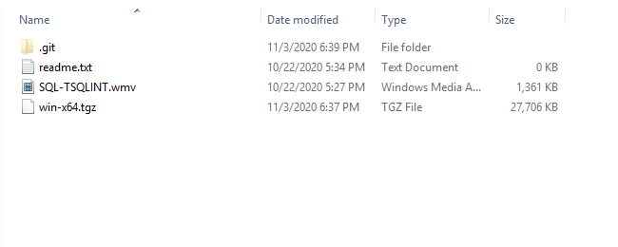
Extract the zip file and you would find below contents

Slide 4
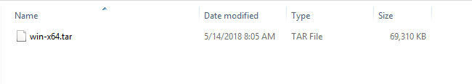
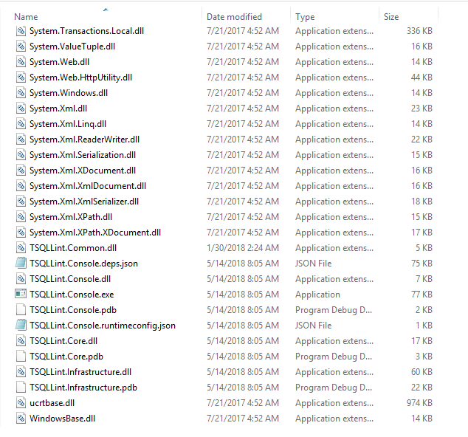
Extract “win-x64.tgz” , you will find a tar file.
Extract “win-x64.tar”, you will find a below files.

Slide 5
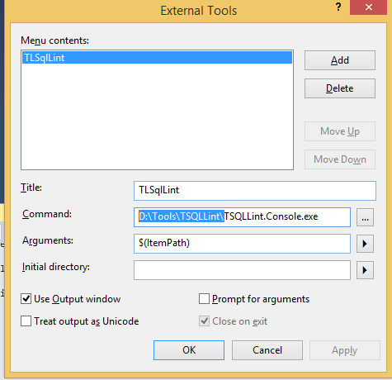
Copy the extracted location. And locate “TSQLLint.Console.exe”, We need to configure this exe with full path in Sql Server Management Studio.
I Have extracted this to “D:\Tools\TSQLLint” , you may whatever directory & folder is apt for you.
Open Sql server Management studio. Click Tools -> External Tools-> Add
Add values as shown in below image , in command field add the Exe path where you extracted the file.

Slide 6
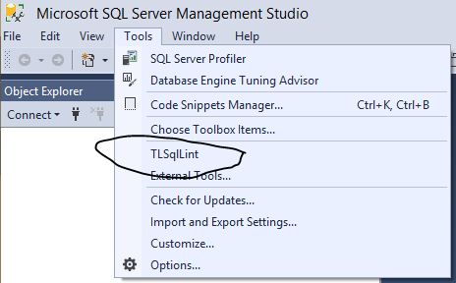
Setup is complete. Now go to Tools menu in SSMS, you should find this option

